Slide 1
MCROBERTS LITERACY UPDATE
MARCH 2, 2026

Slide 2
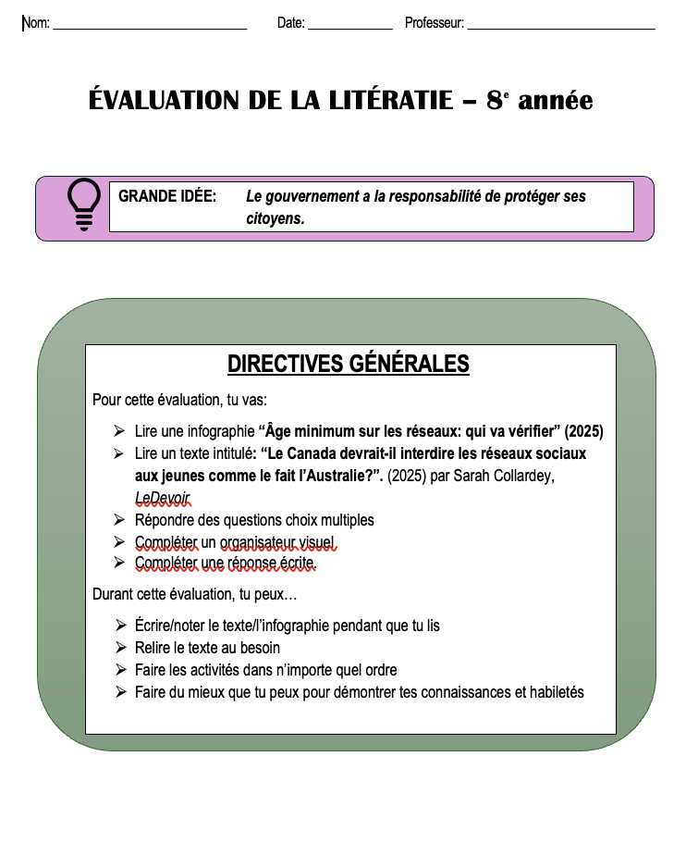
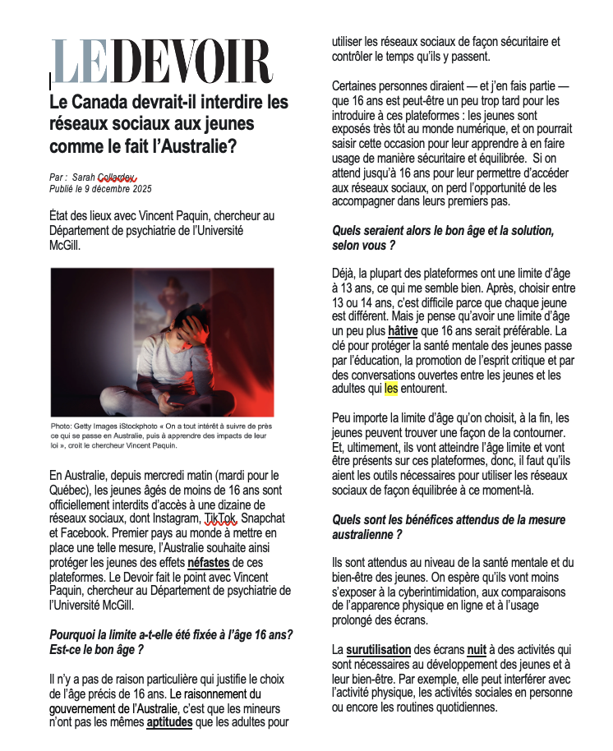
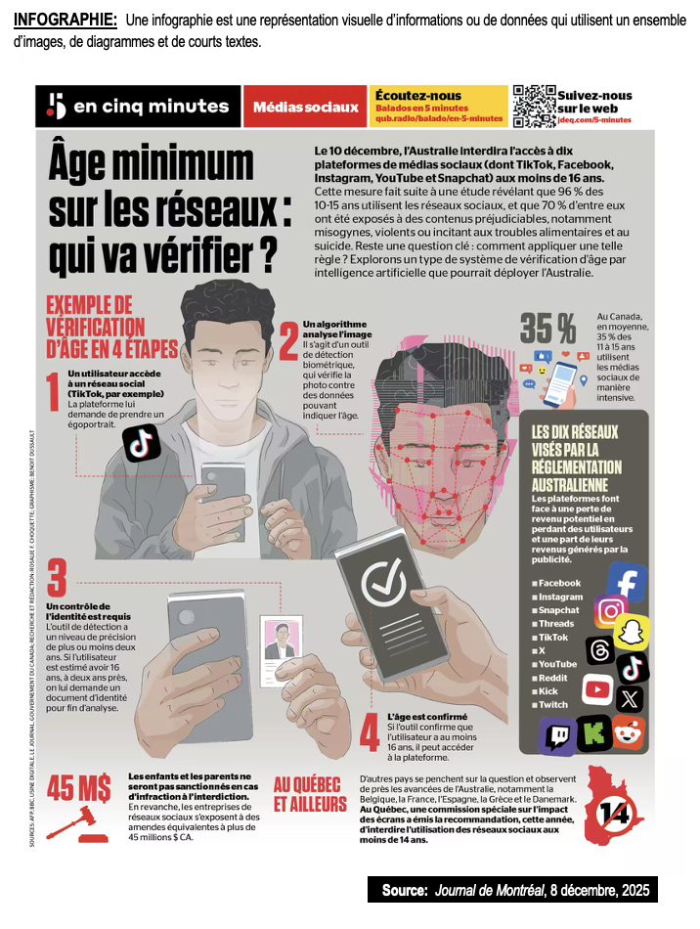
JANUARY 2026
Mid-point PBA check in
88 students in FI did the assessment (5 absent)
Topic: Should Canada follow Australia’s example and ban kids under 16 from accessing social media?

Slide 3
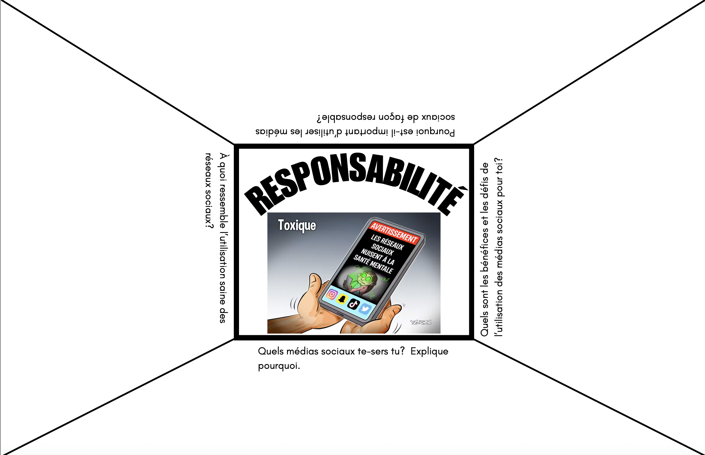
PBA PREP ACTIVITY (Think & Share) *done on the same day
QUESTIONS EXPLORED:
Why is it important to use Social Media responsibly?
What are the benefits and challenges of using Social Media for you?
What Social Media do you use and why?
What does responsible use of Social Media look like?

Slide 4
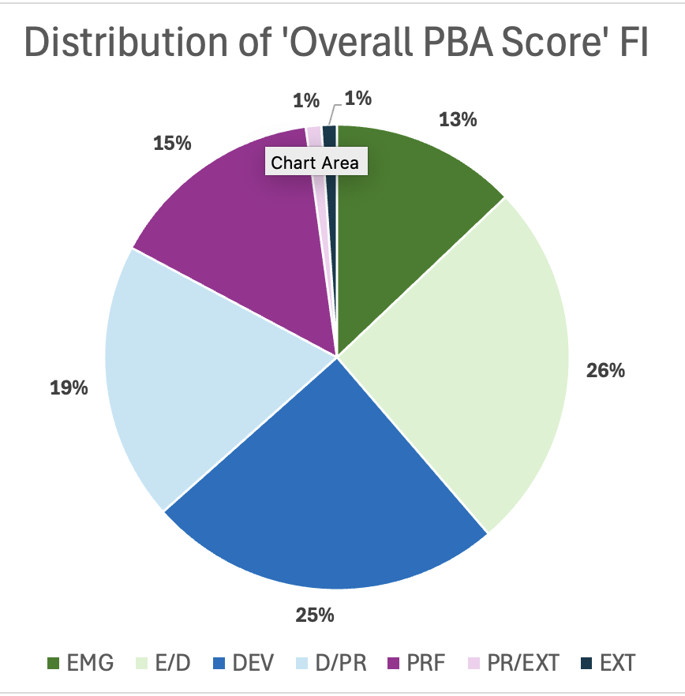
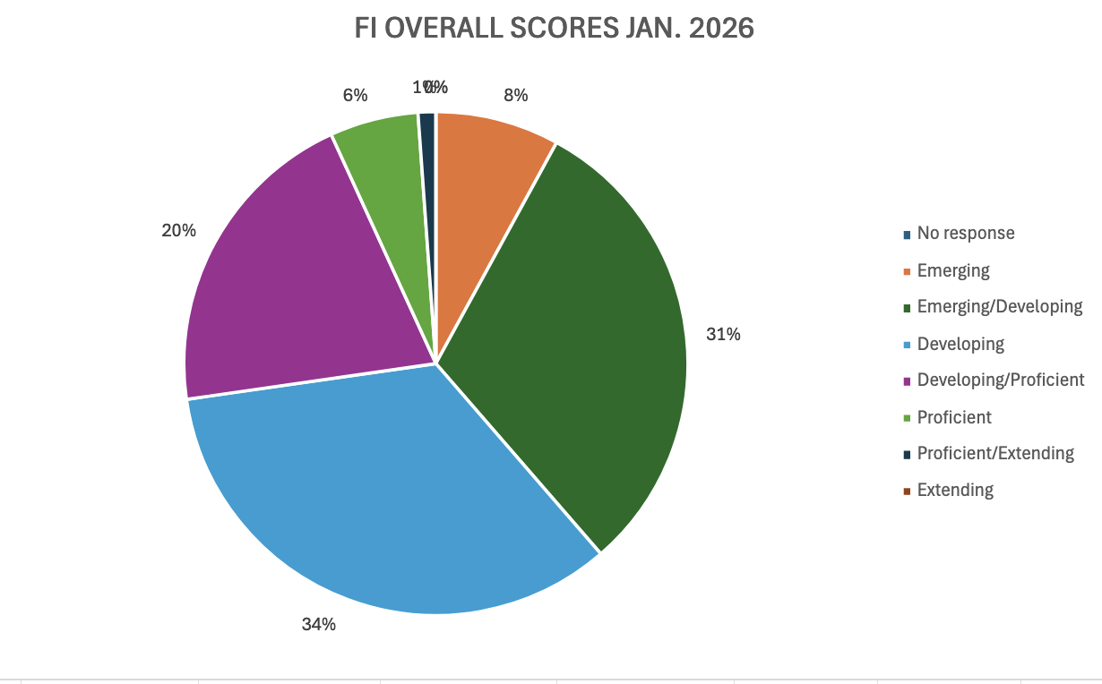
FALL 2025 VS. JANUARY 2026 FI DATA

Slide 5
COMPARING FALL 2025 DATA TO JANUARY 2026 DATA
# of students
Notes:
No significant difference from the Fall…

Slide 6
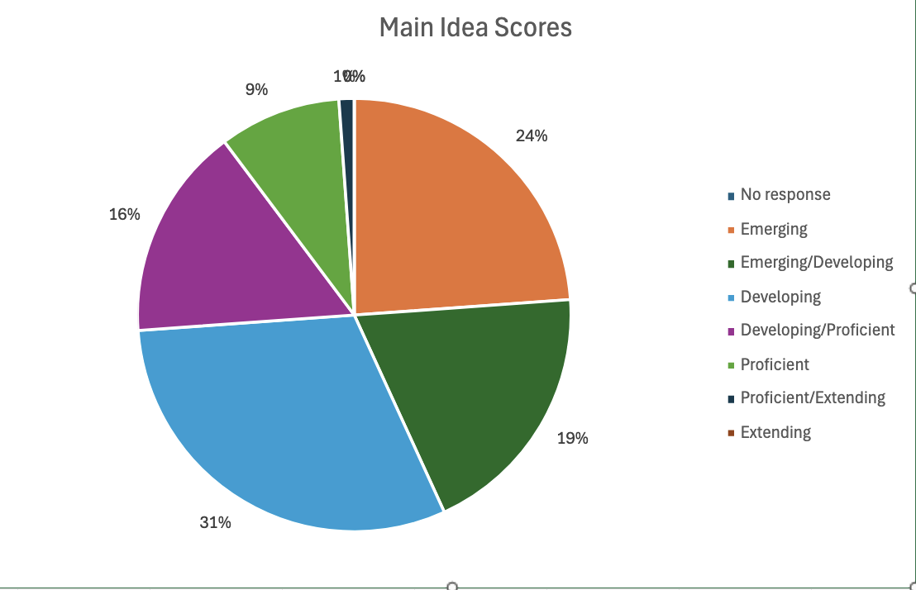
Some takeaways…
43% of FI students scored EMG or EMG/DEV

Slide 7
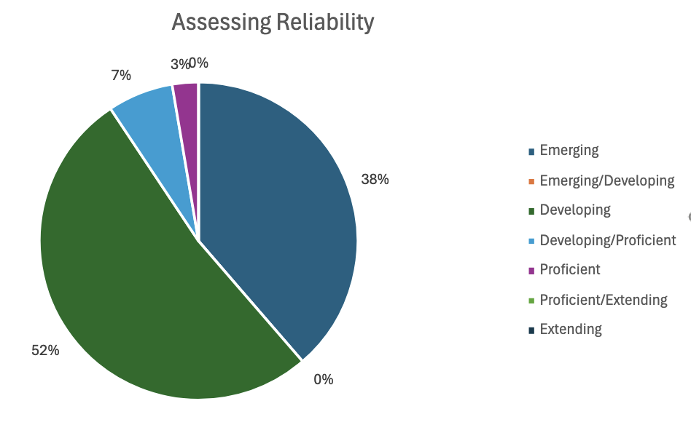
Some takeaways…
38% of FI students scored EMERGING

Slide 8


What did we notice…
Students continue to struggle to identify the main idea and synthesize information
Need more practice assessing reliability
Students continue to work through tasks quickly and not carefully (not reading instructions correctly)
Evidence of word skills work in classes
Notes:
NEED TO USE THE PILLARS OF LITERACY TO GET PROFICIENCY STANDARDS…

Slide 9




NUMERACY SAMPLE ASSESSMENT IN GRADE 9

Slide 10
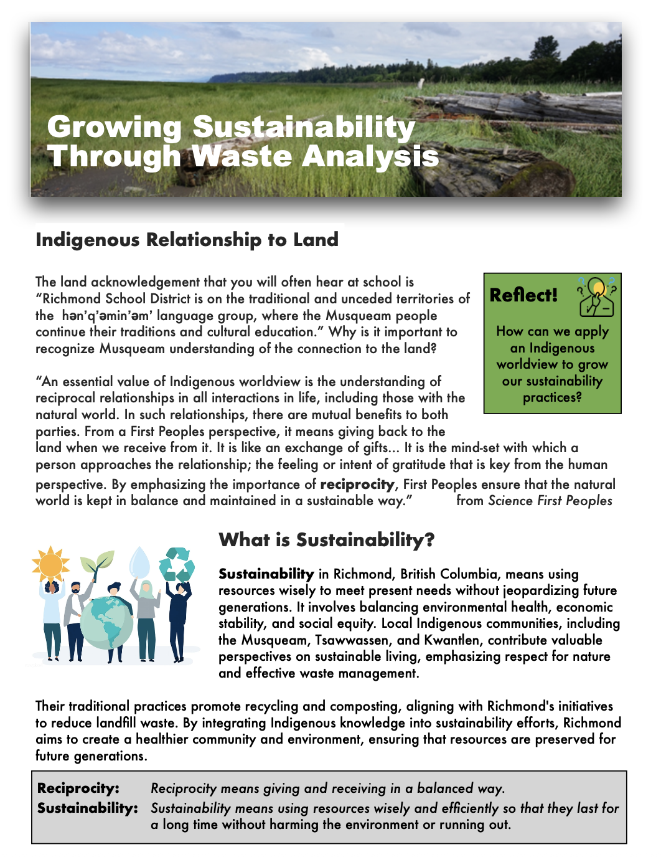
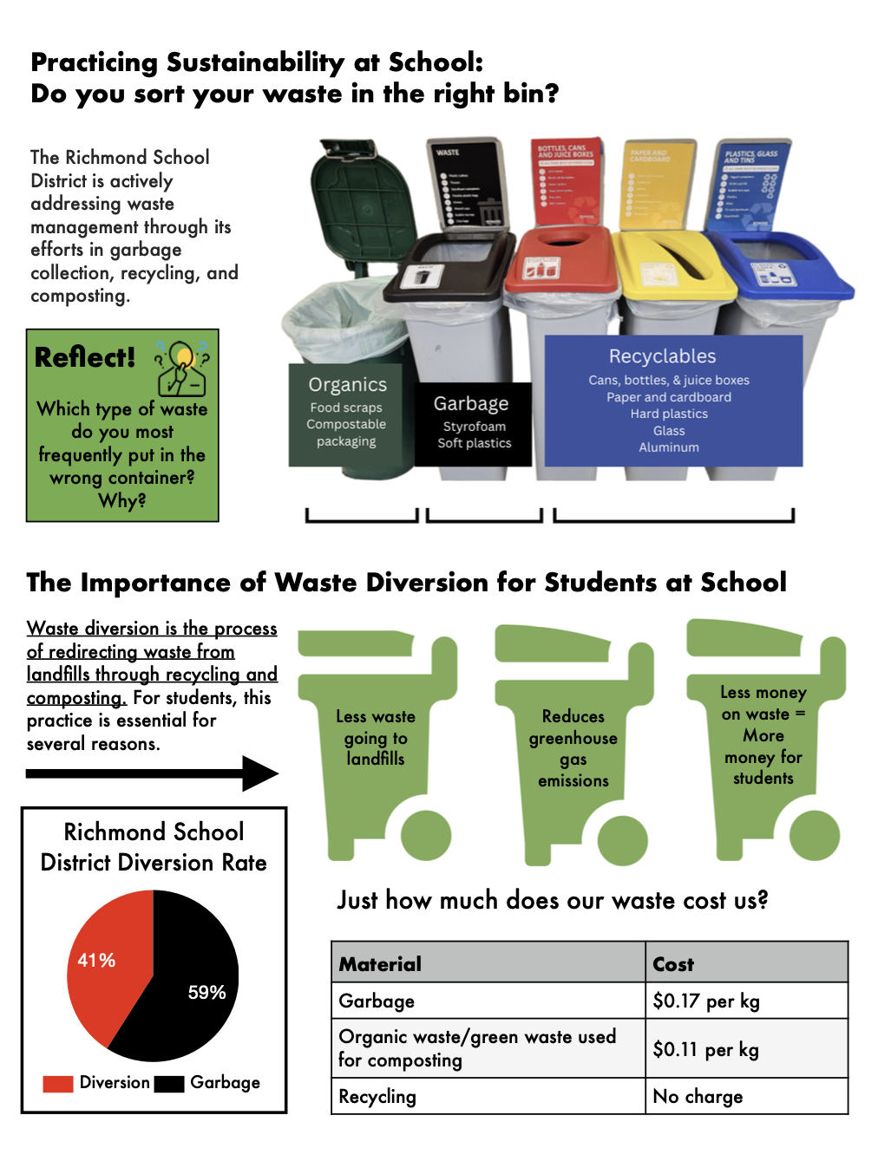
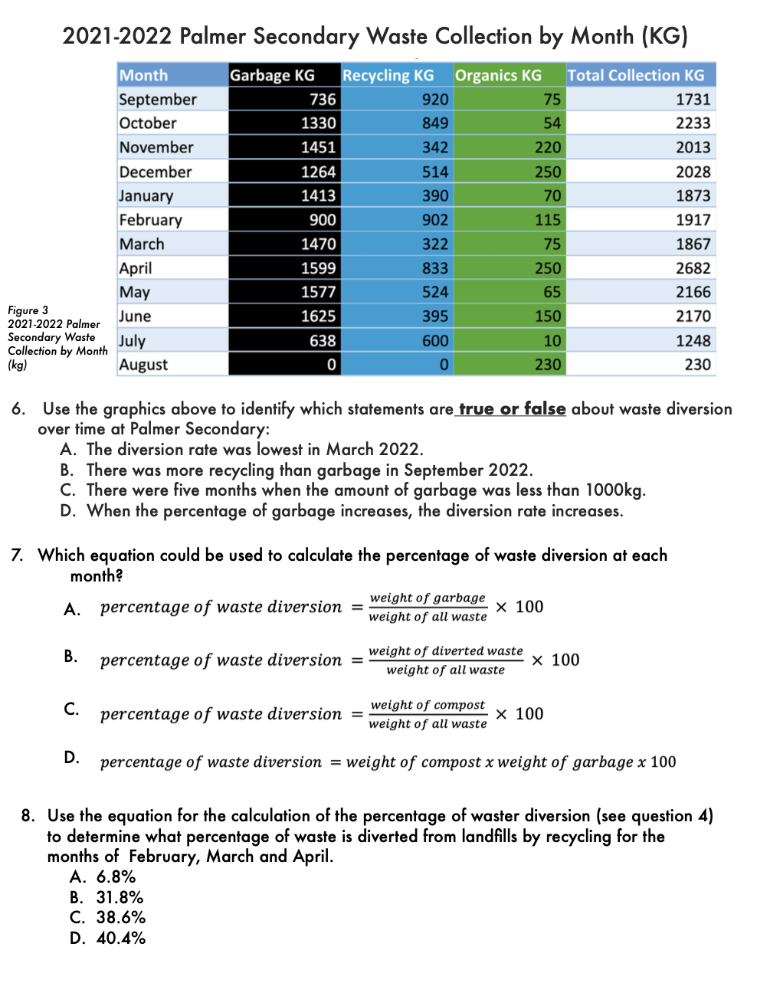
JANUARY 2026
Numeracy sample assessment
22 students in grade 9 did the assessment
Topic: DATA and sustainable waste management in schools
Notes:
Made to look like a GNA assessment; had some literacy and numeracy questions together

Slide 11
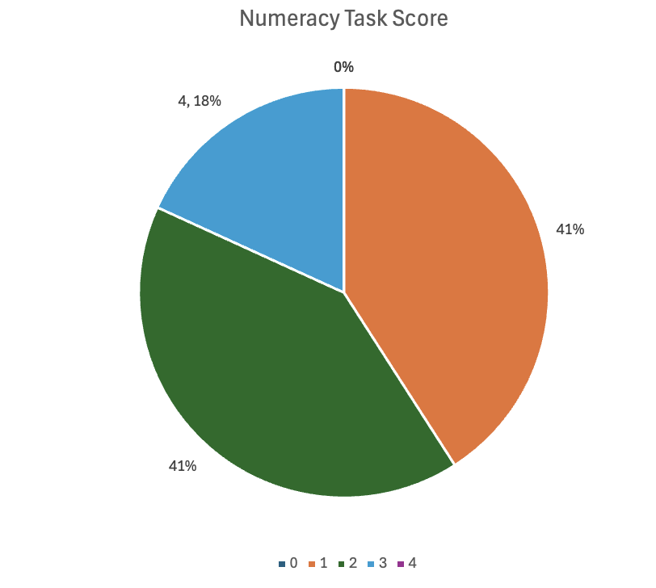
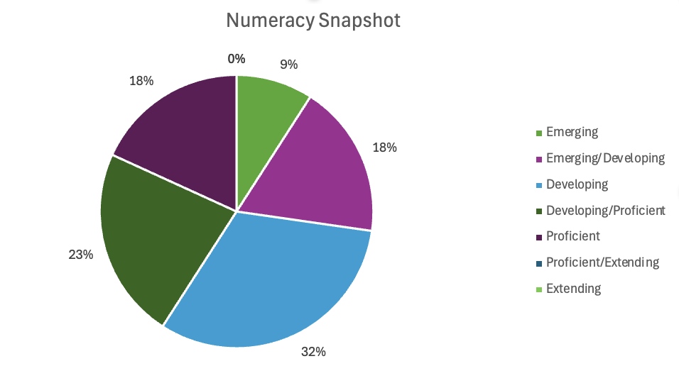
NUMERACY ASSESSMENT DATA

Slide 12
WHAT DID WE NOTICE?
There were some issues with the layout of the assessment. (There was very little space to write responses or calculations.)
Kids need more practice doing “math” and numeracy in other classes.
Kids struggled to transfer literacy skills to the numeracy assessment/task in front of them (word skills, identifying the main idea and making connections)
Notes:
Strengths?

Slide 13
What do we do next?

Slide 14
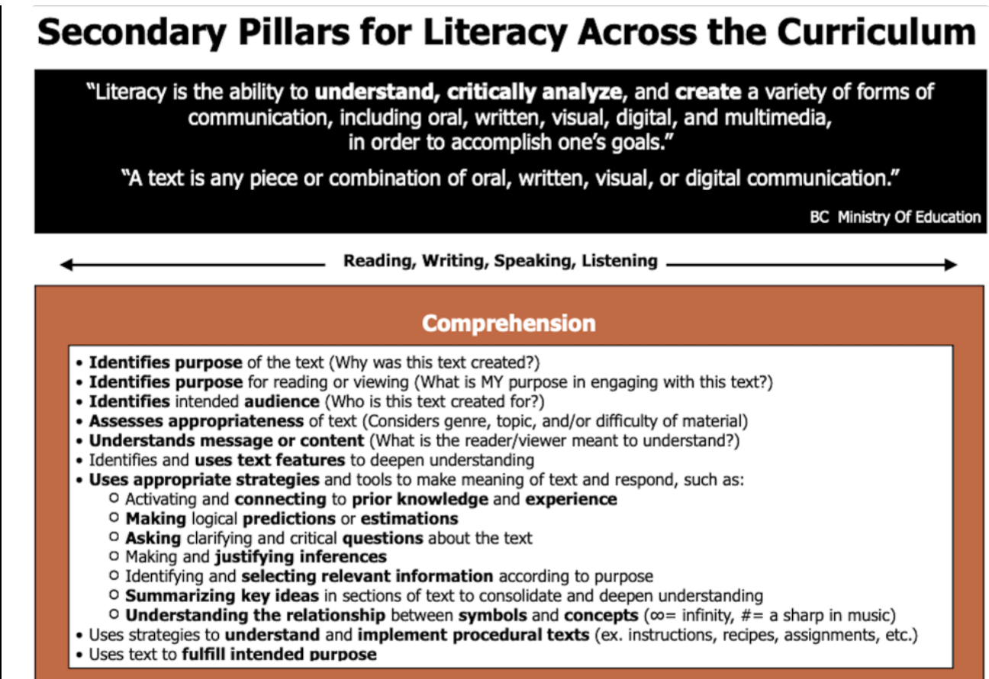
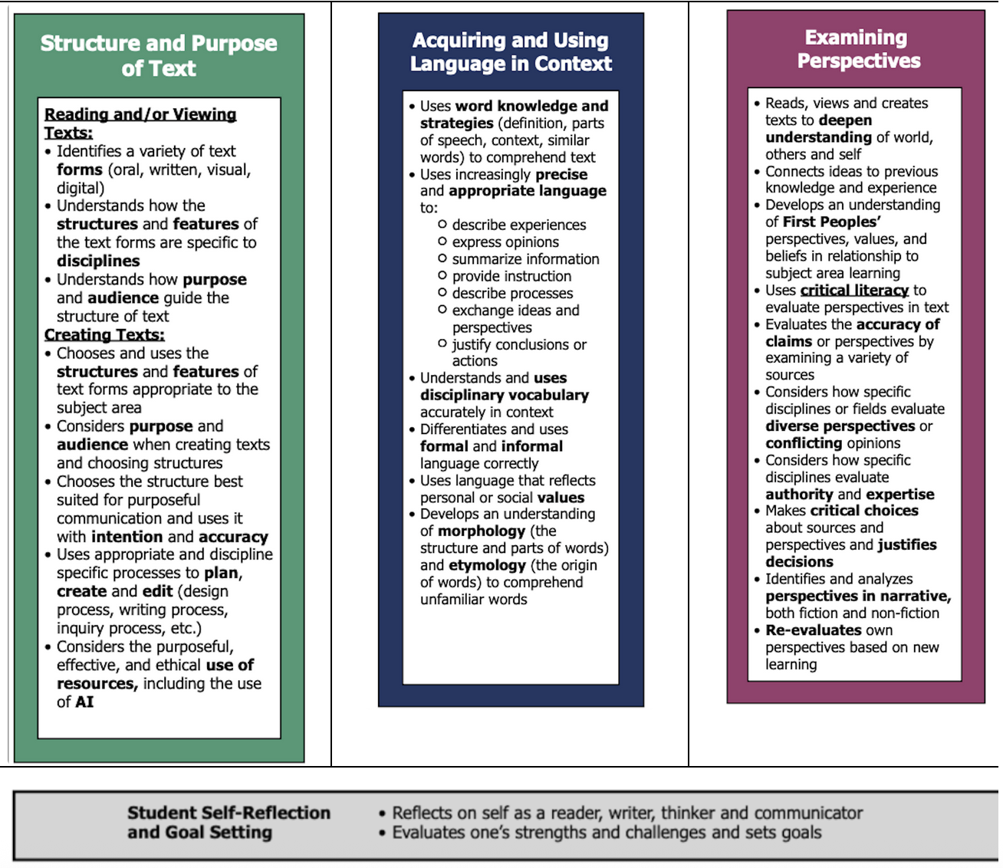
From now until April 28th… (6 weeks)
Focus on the following literacy skills: word skills, main idea, assessing reliability
Use the Pillars of Literacy
Use the NEW Digital Literacy Framework
Bitesized (TEAMS Literacy Channel)
Ask me for support!

